Slide 1
ONLINE FRAUD DETECTION OF BLOSSOM BANK
BY
ADA MOKUYE

Slide 2
PROBLEM STATEMENT
Blossom Bank renders financial services online, experiencing fraudulent transactions cannot be avoided as is basically on the rise. However, the need to build a machine learning model that will be enable the detection of those transactions that are fraudulent, help save the bank from loosing income, making provision for recall of funds and maintain a good reputation .
Description of the dataset
This dataset is related to the direct fraud detection. This was based on the type of transaction, amount, Originator’s name which comes as account number, originator’s balance before and after the transaction. However, isFraud field shows zero(0) as no fraud and one(1) as fraud.

Slide 3
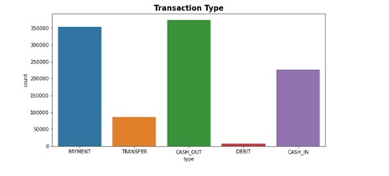
EXPLORATORY DATA ANALYSIS
UNIVATIATE ANALYSIS
This type of data consists of only one variable. The analysis of univariate data is the simplest form od analysis since the information deals with only one quantity that changes. It does not deal with causes or relationships and the main purpose of the analysis is to describe the data and the pattern that exist.

Slide 4
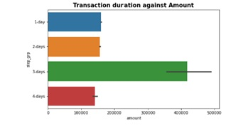
EXPLORATORY DATA ANALYSIS
BIVARIATE ANALYSIS
Bivariate analysis involves two different variables. The analysis of this type of data deals with causes and relationships and analysis is done to find out the relationship among the two variables.
Example is the relationship between transaction duration and Amount.

Slide 5
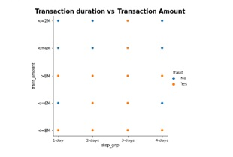
EXPLORATORY DATA ANALYSIS
MULTIVARIATE ANALYSIS
Multivariate involves three or more variables
three variables, you can create a 3-D model to study the relationship (also known as Trivariate Analysis)
Example is the analysis of transaction duration vs amount vs Fraud.

Slide 6
Summary
The data set presented shows that the percentage of fraud is way less than that of no fraud. the accuracy score has been shown by the Algorithms used. Accuracy Score will not ne a good base for our evaluation of our model.
When an already occurred event is predicted correctly is seen as Recall. This is seen as false predictions when they are correct(False Negatives).
The measure of the probability that our model is able to predict fraudulent transactions accurately is precision. predictions that we get correct but are false ( False Positives).
A model with a higher score in recall will be ideal for fraudulent transaction as this will enable fraudulent transactions not to scale through. thereby saving the bank from Loss of fund or provisioning for fraudulent transactions. this will also save Blossom Bank from Reputational damage.
Random Forest model should be deployed as it has the highest recall score compared to other algorithms. Recall score can be improved via model optimization model to give better predictions.

Slide 7
THANK YOU
Ada mokuye

